Slide 1
Microservices Data Consistency Approaches: A tailored approach towards current limitations
PhD 1st Progress
Asim Riaz
1732102
Supervisor:
Dr. Husnain Mansoor Ali

Slide 2
Contents
Problem Statement
Research Objectives
Research Roadmap
Objectives Breakdown
Objective – Part 1
Design Principles
Implementation Ratio
Partial Migrations
Migration Issues
Objective – Part 2
Progress
Q&A

Slide 3
Problem Statement
Software industry heavily relies on custom data consistency implementations while using microservice architecture
Industry have multiple microservices data consistency approaches available at their disposal, however, their adaption is limited
This research will:
Pursue to identify the limitation of existing microservices data consistency approaches
Segregate the limitations that hinder the adaptation of microservices data consistency approaches by industry
Propose potential solutions to overcome selected limitations to increase industry adaptation of microservices data consistency approaches

Slide 4
Research Objectives
Evaluate limitations of microservices data consistency approaches for industry adaptation
Design and proposed adaptation model.
Testing and evaluation of proposed adaptation model.

Slide 5
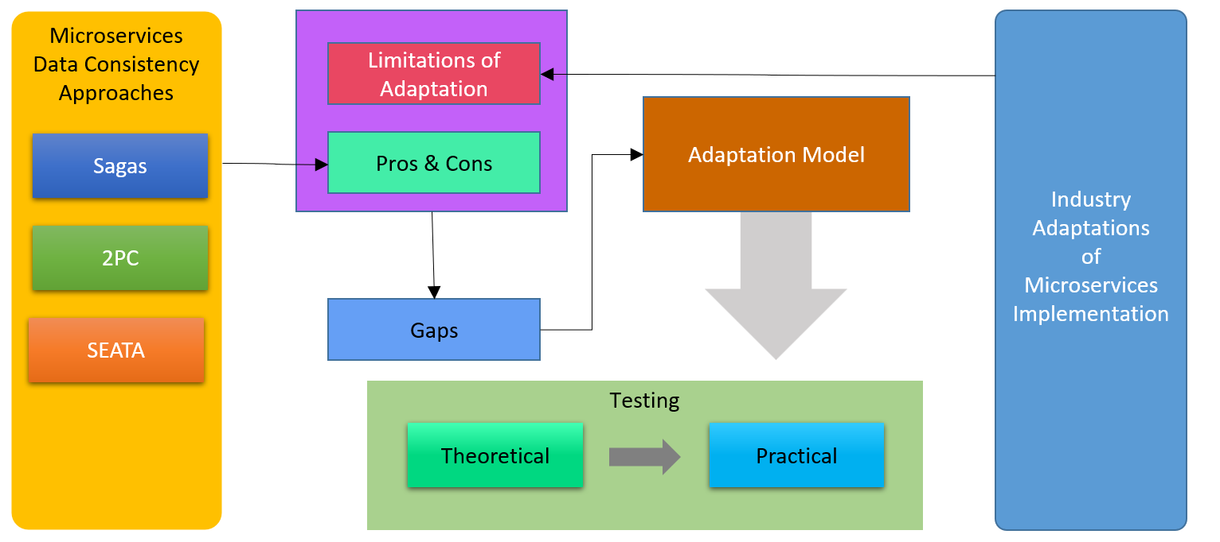
Research Roadmap

Slide 6
Research Objective - Breakdown
Limitations of Industry Adaptations for Microservices Implementations
Pros & Cons of Microservices Data Consistency Approaches / Frameworks

Slide 7
Limitations of Industry Adaptations for Microservices Implementations Background

Slide 8
Microservice - The Core Design Principles
Loose Coupling
This is achieved by only exposing the standard based APIs, so that any changes in the implementation of the Microservice will be completely transparent.[3]
Autonomy
Autonomy is the measure of control that the Microservice has over its runtime environment and database schema during implementation.[3]
By virtue of being independent of each other, Microservices have the opportunity to cut off communication to a failed Microservice that it is collaborating with. [3, 7]
This technique stops individual Microservice failures from propagating through the larger business solution. [8]
Event‑Driven Architecture
In this architecture a Microservice publishes an event when something notable happens. [1]
Other Microservices subscribe to those events and when a Microservice receives an event it can update accordingly, which might lead to more events being published. [1, 5]

Slide 9
Towards Microservices from Monolithic
The majority of microservices architecture adaptations are migration from traditional monolithic architecture. Which does not follow the overall core design principle[1, 6]

Slide 10
Microservice – Partial Migration
Micro
Service
1
Micro
Service
2
Micro
Service
3
Micro
Service
4
Data Layer

Slide 11
Microservice – Migration Issues
Functional Decomposition
Domain Driven Design[1, 8]
Database Decomposition
Data Coupling among Services
Deployment
Complex Service Configurations
Capture Service Dependencies
Modularity [8]
Legacy Systems are Hard to Migrate
Complex dependencies [12]
Strangler Pattern [13]
Anti-Corruption Layer Pattern.[13]

Slide 12
The Problem: Data Consistency in Distributed Systems
A shared relational database handles and ensures data consistency for monolithic applications via ACID transactions.
Atomicity, Consistency, Isolation and Durability
In a microservice architecture, there is no single unit of work and no central database.
The business logic is distributed across various native transactions.
This means that in a microservice architecture, a single transaction unit of work cannot be used across databases, which violates the rule of an ACID transaction, but it is necessary for data consistency

Slide 13
Possible Solution
To begin with, there is no single solution that works well in every situation. Depending primarily on the use case, various solutions can be implemented. In a microservice architecture there are two main approaches to maintaining data consistency:
Distributed Transaction
Eventual Consistency

Slide 14
Possible Solution
Distributed Transaction
In a distributed transaction, transitions are carried out on multiple services, databases, and message queues. A distributed transaction manager ensures data integrity through all different databases. The complexity of distributed transactions is high because multiple resources are affected in a distributed transaction.
Eventual Consistency
The eventual consistency model emphasizes high availability in distributed systems. In this model, discrepancies are tolerated for a brief period until the distributed data problem is solved. This model uses the BASE database model instead of following distributed ACID transactions between microservices. As comp

Slide 15
BASE Model
As compared ACID model which delivers consistency, the BASE database model offers high availability. The eventual consistency model is used by the common pattern known as SAGA
Basically Available: It replicates the data among the nodes of the database cluster to guarantee its availability.
Soft State: Data may fluctuate over time due to a lack of significant consistency. The developers are in charge of maintaining consistency.
Eventual Consistency: Although immediate consistency may not be attainable with the BASE, it will be achieved gradually ensured relatively after a short time.

Slide 16
Pros & Cons of Microservices Data Consistency Approaches

Slide 17
Microservice - Data Consistency Approaches
2PC (Two Phase Commit)
SAGAS Pattern
SEATA

Slide 18
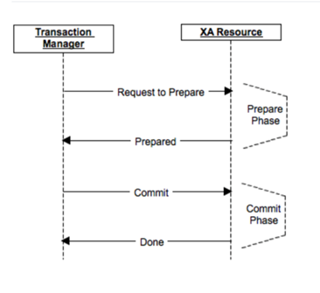
Two Phase Commit – 2PC
In 2PC, a coordinator transaction observes the whole business process’s integrity. If all sub-transactions are complete successfully, it commits the transaction successfully. On the other hand, if any sub-transaction fails to complete, the coordinator transaction calls rollback all successful transactions to a consistent state

Slide 19
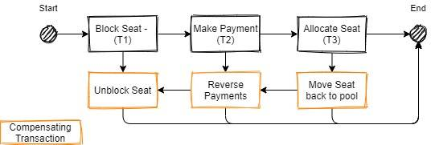
SAGA Pattern
The Saga pattern handle transaction in a distributed manner. Transaction control is dependent upon each microservices as compared to a whole transaction handling all microservices.
All transactions will be executed sequentially one after another. If any subsequent microservice failed to complete its transaction, a compensation action will be triggered to roll back the transaction to maintain consistency.

Slide 20
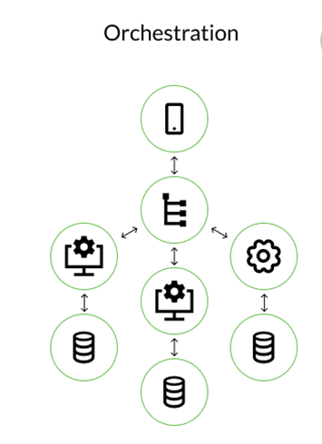
SAGA Pattern: Orchestration
In orchestration, transactions are sequenced in accordance with business logic by a coordinator service known as Saga Execution Orchestrator (SEG). The orchestrator chooses which operation needs to be carried out. The orchestrator should reverse the prior actions if an operation fails, this process is called compensation operation.

Slide 21
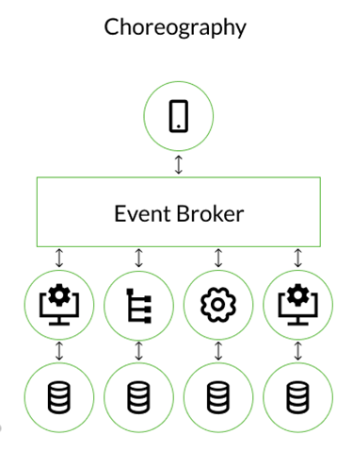
SAGA Pattern: Choreography
In choreography, an event broker has a primary role if you want to coordinate between microservices and have a mechanism of sending messages between them whenever anything occurs.
Following the completion of a task, each service creates an event, and each service monitors events to take appropriate action.

Slide 22
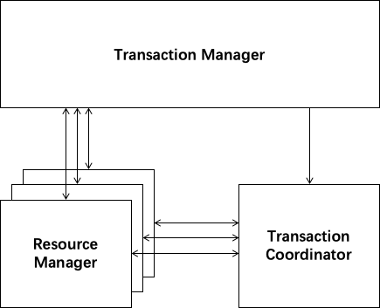
SAGA Pattern: SEATA
SEATA is an open-source framework for handling distributed transactions based on java. SEATA works on different modes in which XA, TCC, and Saga are included.
In SEATA XA mode is implemented as a 2PC model and Saga works as it is.
TCC works on a Try, Confirm and Cancel basis. In the trial phase, all sub-transaction participated in the distributed transaction to acquire business resources.

Slide 23
Research Work Limitations

Slide 24
Two Phase Commit
There is no mechanism to roll back the other transaction if one microservice goes down during the commit step.
While the slowest service completes its confirmation, other services must wait. Until the entire transaction is finished, the resources needed by the services remain locked.
Due to their reliance on the transaction coordinator, 2PC commits are slow by design. This can lead to scalability problems, especially in microservices-based applications and in scenarios where there are a lot of services involved in a roll-back.

Slide 25
SAGA Pattern
SAGA does not provide a precise technique to estimate the length of time it will take for a system to reach a consistent state, hence eventual data consistency is not guaranteed.
Doesn’t have read isolation, requires more work, for example, the user might view the operation being done, but it is cancelled owing to a compensation transaction in a few seconds.
When a service instance count gets higher, it was challenging to debug
An increase in development costs is a result of the real service developments and the compensation that goes along with them.
Compensation transactions make designs more complicated.

Slide 26
SAGA Pattern: Orchestration
Due to the possibility of multiple calls inside the retry mechanism, compensation operation must be idempotent.
When data has been altered by another transaction, it might not already be possible to undo the changes.
Compensation operations have a high complexity rate in a multi-instance microservice environment.

Slide 27
SAGA Pattern: Choreography
The state of the service is maintained by the event store usually worked as a message broker. States can be rebuilt by repeating an event from the event store for services.
The scope of the choreograph microservice may impact the performance of the transaction.
The higher number of steps in a transaction may lead to increase complexity, It is challenging to keep track of which services attend various events

Slide 28
Design Considerations
If at all feasible, keep away of utilizing distributed transactions between microservices. Complex challenges arise while working with dispersed transactions.
Create your system with as little reliance on distributed consistency as you can. To do this, note the following transaction boundaries.
Decide which operations must take place inside the same work unit. For this kind of task, need strong consistency.
Determine whether operations are consistent enough to withstand any potential delays. For this kind of procedure, use eventual consistency.
If you want to use asynchronous, non-blocking service calls, think about employing event-driven architecture.
To maintain consistency, create fault-tolerant systems using compensation and reconciliation procedures.
A shift in perspective is necessary for creation and development of eventual consistent patterns.

Slide 29
Demo - Log
PhD/2PC.md at main · asmryz/PhD (github.com)
PhD/mp-shadingsphere-druid-seata-tcc.md at main · asmryz/PhD (github.com)
PhD/Saga Choreography.md at main · asmryz/PhD (github.com)

Slide 30
References
Laigner, R., Zhou, Y., Salles, M.A.V., Liu, Y. and Kalinowski, M., 2021. Data Management in Microservices: State of the Practice, Challenges, and Research Directions. arXiv preprint arXiv:2103.00170.
Xiang, Q., Peng, X., He, C., Wang, H., Xie, T., Liu, D., Zhang, G. and Cai, Y., 2021. No Free Lunch: Microservice Practices Reconsidered in Industry. arXiv preprint arXiv:2106.07321.
Waseem, M., Liang, P., Shahin, M., Ahmad, A. and Nassab, A.R., 2021. On the Nature of Issues in Five Open Source Microservices Systems: An Empirical Study. In Evaluation and Assessment in Software Engineering (pp. 201-210).
BaA¡karada, S., Nguyen, V. and Koronios, A., 2018. Architecting microservices: Practical ˚ opportunities and challenges. Journal of Computer Information Systems.
Laigner, R., Kalinowski, M., Diniz, P., Barros, L., Cassino, C., Lemos, M., Arruda, D., Lifschitz, S. and Zhou, Y., 2020, August. From a monolithic big data system to a microservices event-driven architecture. In 2020 46th Euromicro Conference on Software Engineering and Advanced Applications (SEAA) (pp. 213-220). IEEE.
Kuryazov, D., Jabborov, D. and Khujamuratov, B., 2020, October. Towards decomposing monolithic applications into microservices. In 2020 IEEE 14th International Conference on Application of Information and Communication Technologies (AICT) (pp. 1-4). IEEE.
Two Phase Commit. (2022). Available at: https://tbindi.github.io/tale/images/two.png.
Microservices in the enterprise, 2021: Real benefits, worth the challenges. (2021). IBM Market Development Insights.
Daja, D., 2020. Data Transformation: An Overview.
Laigner, R., Zhou, Y. and Salles, M.A.V., 2021, June. A distributed database system for event-based microservices. In Proceedings of the 15th ACM International Conference on Distributed and Event-based Systems (pp. 25-30).

Slide 31
References
Bailis, P. and Ghodsi, A., 2013. Eventual consistency today: limitations, extensions, and beyond. Communications of the ACM, 56(5), pp.55-63.
Microservice Orchestration and Choreography by Dev.Pro. (n.d.). Available at: https://dev.pro/wp-content/uploads/2022/03/Microservice-Orchestration-andChoreography-by-Dev.Pro.png[Accessed24Jun.2022].
Taibi, D., Lenarduzzi, V. and Pahl, C., 2017. Processes, motivations, and issues for migrating to microservices architectures: An empirical investigation. IEEE Cloud Computing, 4(5), pp.22-32.
Vale, G., Correia, F.F., Guerra, E.M., de Oliveira Rosa, T., Fritzsch, J. and Bogner, J., 2022, March. Designing Microservice Systems Using Patterns: An Empirical Study on Quality Trade-Offs. In 2022 IEEE 19th International Conference on Software Architecture (ICSA) (pp. 69-79). IEEE.
HaselbA¶ck, S., Weinreich, R. and Buchgeher, G., 2018, November. An expert interview ˜ study on areas of microservice design. In 2018 IEEE 11th Conference on Service-Oriented Computing and Applications (SOCA) (pp. 137-144). IEEE.
Bogner, J., Fritzsch, J., Wagner, S. and Zimmermann, A., 2019, March. Microservices in industry: insights into technologies, characteristics, and software quality. In 2019 IEEE international conference on software architecture companion (ICSA-C) (pp. 187-195). IEEE.
SA¶ylemez, M., Tekinerdogan, B. and Koluk ˜ A¨ ±saTarhan,A.,2022.Feature − DrivenCharacterizationo f MicroserviceArchitectures: ASurveyo ftheStateo fthePractice.AppliedSciences,12(9), p.4424.
Blinowski, G., Ojdowska, A. and PrzybyAek, A., 2022. Monolithic vs. Microservice Archi- ˚ tecture: A Performance and Scalability Evaluation. IEEE Access, 10, pp.20357-20374.
seata.io. (n.d.). Seata. [online] Available at: https://seata.io/en-us/ [Accessed 2 Feb. 2022].
Wu, M., Zhang, Y., Liu, J., Wang, S., Zhang, Z., Xia, X. and Mao, X., On the Way to Microservices: Exploring Problems and Solutions from Online QA Community.

Slide 32
Question & Answer Session
Thank you

